Slide 1
Design of Accumulated Stability Voting (ASV)
Fred Xu, Matthew Kim, Minh Quan
Yang, T.-Y., Lin, Y.-Y. & Chuang, Y.-Y., “Accumulated Stability Voting: A Robust Descriptor from Descriptors of Multiple Scales,” in Proc. IEEE Conf. on Computer Vision and Pattern Recognition (CVPR), Las Vegas, NV, USA, Jun.–Jul. 2016, pp. 327-335. doi:10.1109/CVPR.2016.42.

Slide 2
Agenda
Problem Definition
Class Implementation
Data Structure
Test Data & Methodology
Initial Results

Slide 3
Problem Definition
Problem:
Traditional descriptors typically use a single scale per keypoint.
Incorrect scale leads to poor robustness.
ASV-SIFT was implemented using VLFeat & MATLAB library by the authors.
Project Goals:
Implement the ASV framework in C++/OpenCV.
Integrate ASV with OpenCV SIFT & BRISK.
Evaluate ASV on Oxford dataset.
Explore alternative thresholding strategies.

Slide 4
What Already Exists
OpenCV:
Keypoint detectors & descriptors
cv::SIFT & cv::BRISK
Matching & visualization
cv::BFMatcher & cv::drawMatches
External:
Original ASV implementation in VLFeat & MATLAB
Public datasets
Oxford Affine Covariant Regions dataset

Slide 5
ASV Pipeline
Keypoint detection
Detect keypoints with SIFT.
Multiscale descriptor extraction
For each keypoint, sample patches at scale λ_{s}σ,…,λ_{l}σ.
Extract SIFT descriptor at each samples scale.
Stability computation
For each pair of scales (i, j): v_{i, j} = |x_{i} - x_{j}| (element wise absolute difference).
Entropy-based thresholding
For each v_{i, j}, choose threshold as median of its 128 elements.
Accumulated stability voting
Sum votes across all pairs ->real-valued ASV descriptor C.
Optional second-stage thresholding
Quantize C into a binary descriptor.

Slide 6
Class Definition
Class ASV {
public:
ASV(int nScales, int scaleStep, int nThreshold1, int nThreshold2, bool
isInterpolated)
compute(Mat image, vector<Keypoint>keypoints, vector realOutput, vector
binaryOutput)
private:
nScales: int
scaleStep: int
nThreshold1: int
nThreshold2: int
isInterpolated: bool
calculateThresholds(int nThreshold, vector input, vector output)
computeVote(vector input, vector thresholds, vector output)
}

Slide 7
Data Structure
State Vectors
SIFT descriptor: x = float[nBins]
Stability vector: v^{m} = float[nBins]
multiScaleDescriptor: z_{n} = [nKeypoints][nScales][x]
Thresholds
firstThresholds = float[nThresholds]
secondThresholds = float[nThresholds]
Descriptors
realASV = [nKeypoints][nBins]
binaryASV = [nKeypoints][nBins]

Slide 8
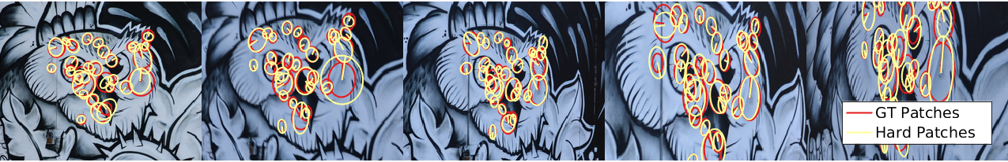
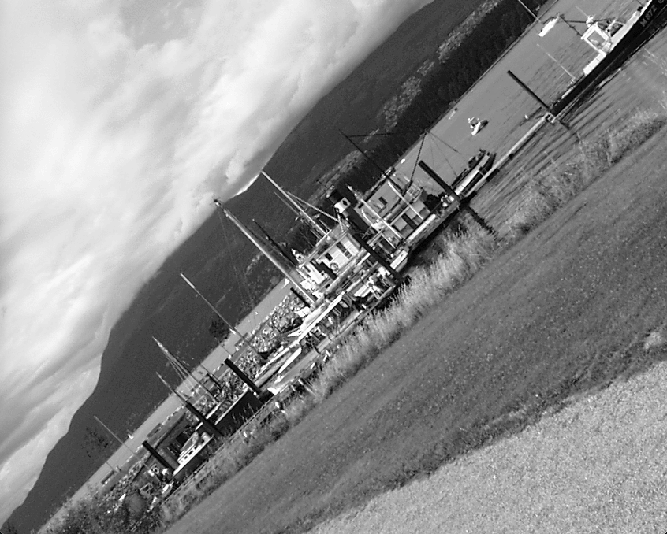
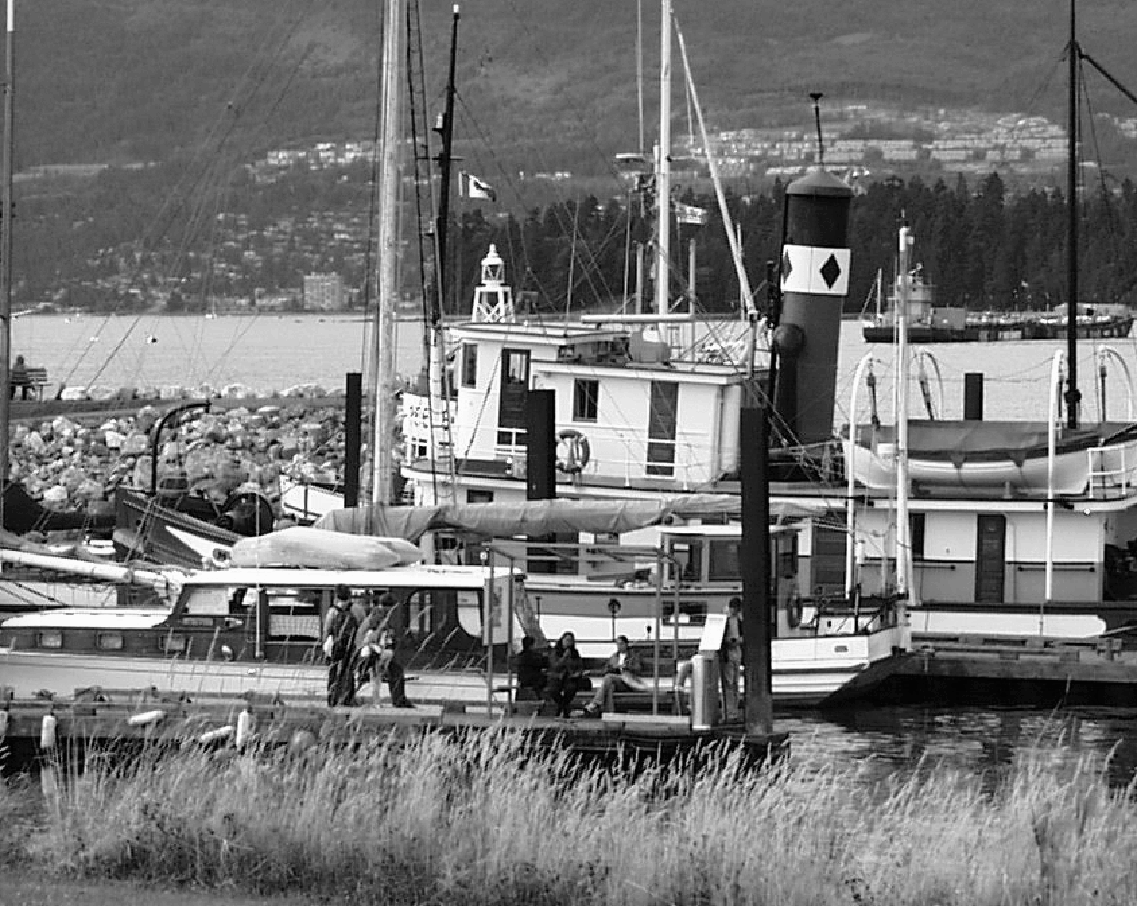
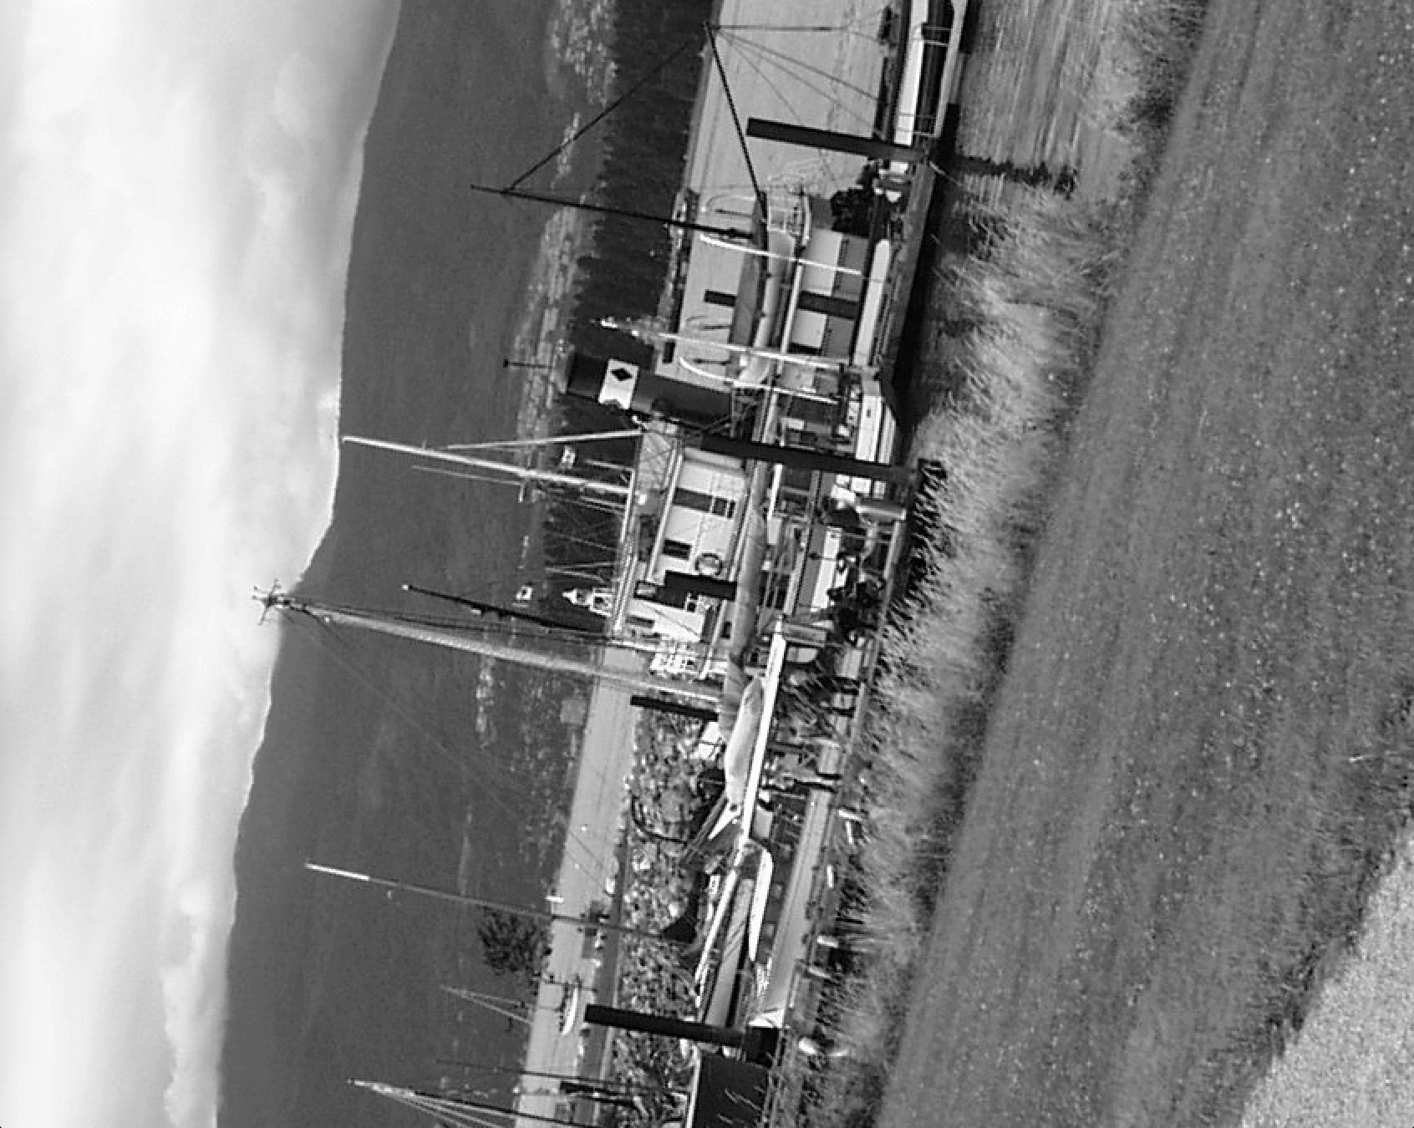
Test Data & Methodology
Test data
Both datasets provide ground-truth homographies
HPatches (https://github.com/hpatches/hpatches-dataset )
Oxford Affine Covariant Regions (https://www.robots.ox.ac.uk/~vgg/research/affine)

Slide 9
Test Data & Methodology
Evaluation pipeline
Load image pair + ground-truth homography (Oxford / HPatches).
Detect keypoints with OpenCV SIFT.
Compute descriptors:
SIFT (baseline)
ASV-SIFT
Match descriptors via BFMatcher (nearest-neighbor distance)
Check correctness (reprojection error)
Reproject keypoint from image A → image B using the homography
Compute the reprojection error
Mark match as correct if error < ε pixels (flat threshold e.g. ε = 3)
Compute PR curve
Compute AP per image
Aggregate and compute mAP across all image pairs

Slide 10
Test Data & Methodology
Metrics
Accuracy:
mAP
Precision–Recall curves
Efficiency:
Descriptor extraction time
Matching time per image pair
Descriptor size (bytes)

Slide 11
Initial Results
Completed Work
Obtained image dataset
Added header and class implementation file
Started on multiscale stability vector calculations
Remaining Work
OpenCV implementation for SIFT based ASV
1st stage thresholding
Vote accumulation
2nd stage thresholding
Add BRISK based ASV
Run tests and gather data
Calculate mAP
Collect runtime performance
Generate match images

